Slide 1
Installing MySQL 5.7 on Microsoft Windows
PBC details here

Slide 2
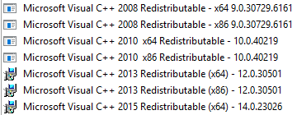

1. Pre-installation requirements
MySQL Community 5.7 Server requires the Microsoft Visual C++ 2013 Redistributable Package to run on Windows platforms.
Make sure the package has been installed on the system before installing the server.
By checking Control Panel → Programs and Features you will find all installed Visual C++ Redistributable in your system.

Slide 3
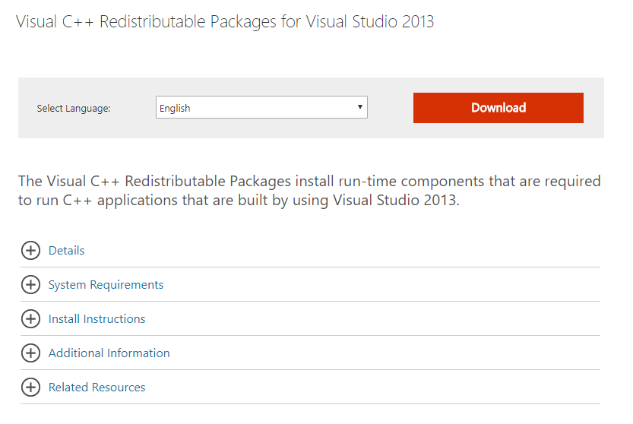
1.1. Downloading the Microsoft Visual C++ 2013 Redistributable Package
Microsoft Visual C++ 2013 Redistributable Package is available at: https://www.microsoft.com/en-us/download/details.aspx?id=40784

Slide 4
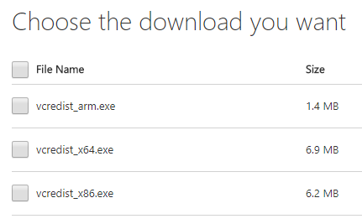

1.2. Choose the download
The redistributable packages are not installed to support your operating system, they are installed to support your application.
Because the MySQL Installer is a 32 bit (x86) program, we need to install vcredist_x86.exe.

Slide 5
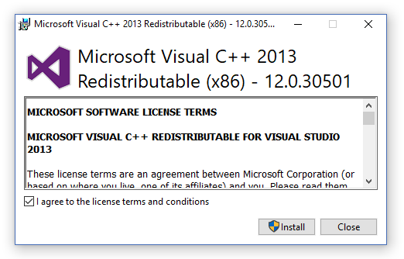
1.3. Install chosen vcredist
Click on vcredist_x86.exe to run the installer.
Check in to agree to the license terms and conditions and click Install.
After successful installation, restart your computer.

Slide 6
2. MySQL Community Server installation
The simplest and recommended method is to download MySQL Installer (for Windows) and let it install and configure all of the MySQL products on your system.
Download MySQL Installer from http://dev.mysql.com/downloads/installer/

Slide 7
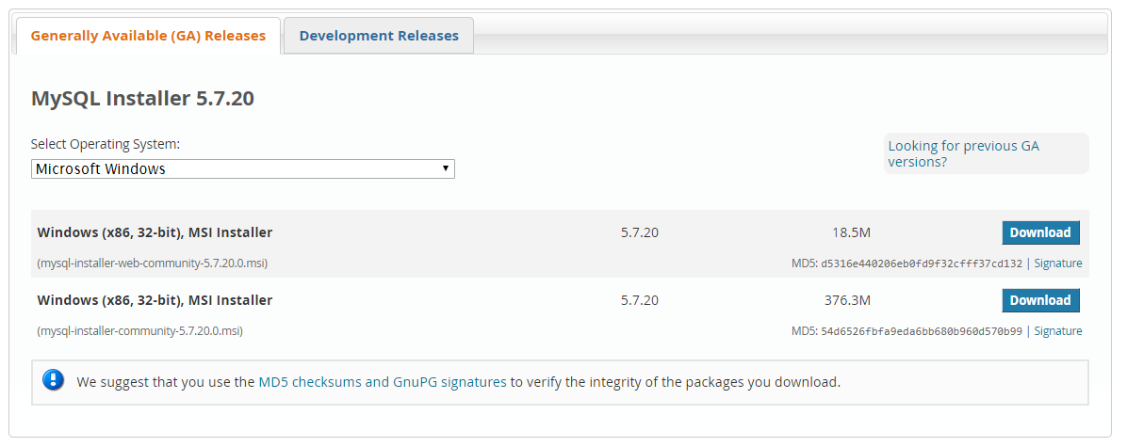
2.1. Choose and download the installer
Unlike the standard MySQL Installer, the smaller "web-community" version does not bundle any MySQL applications but it will download the MySQL products you choose to install.

Slide 8
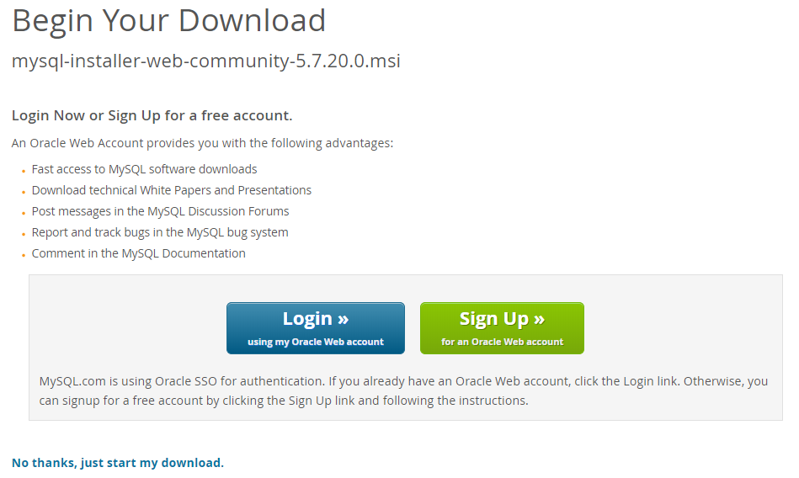
2.2. Sign Up/Login
You will be asked to Login or Sign Up for a free account.
You can choose to do that, but there is an option to proceed without logging in.

Slide 9
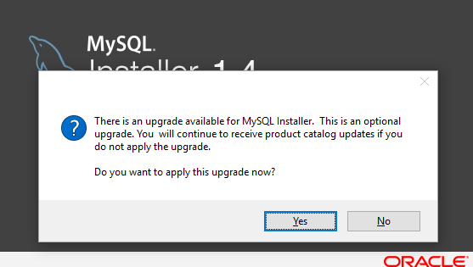
2.3. Run the downloaded installer
Run the mysql-installer-web-community-5.7.20.0.msi .
If required to upgrade MySQL Installer, you can choose No option.

Slide 10
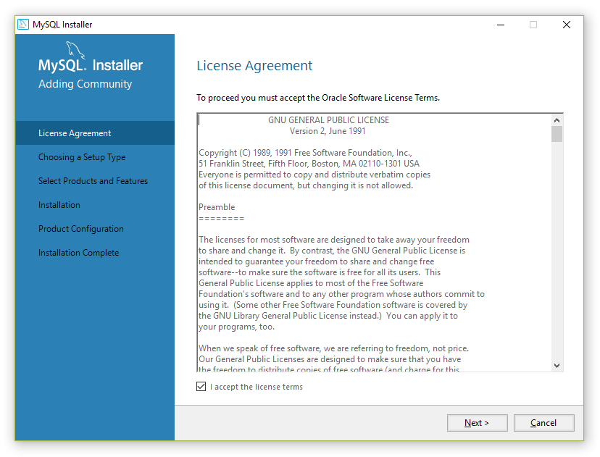
2.4. Accept the Licence Agreement
Check in the «I accept the licence terms»
and click on «Next».

Slide 11
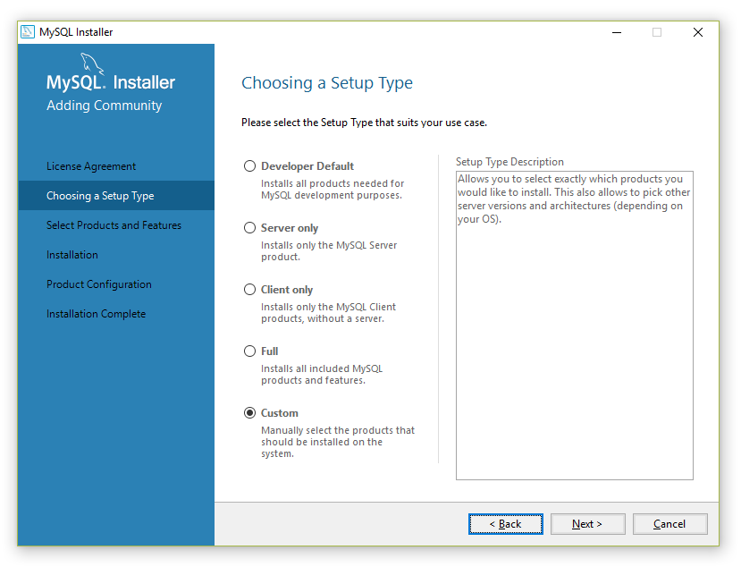
2.5. Choose a Setup Type
To ease the installation and acquire most of the components:
Choose Developer Default, click Next, and click Back;
Then choose Custom and click Next.

Slide 12
2.6. Deselect unneeded components
Deselect unneeded components:
MySQL For Excel;
MySQL for Visual Studio;
Connector/NET;
Connector/Phyton.

Slide 13
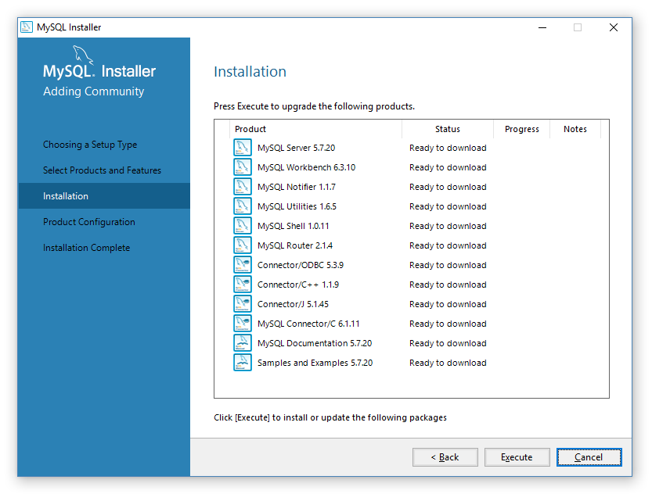
2.7. Install packages
Click Execute to install the chosen packages.

Slide 14
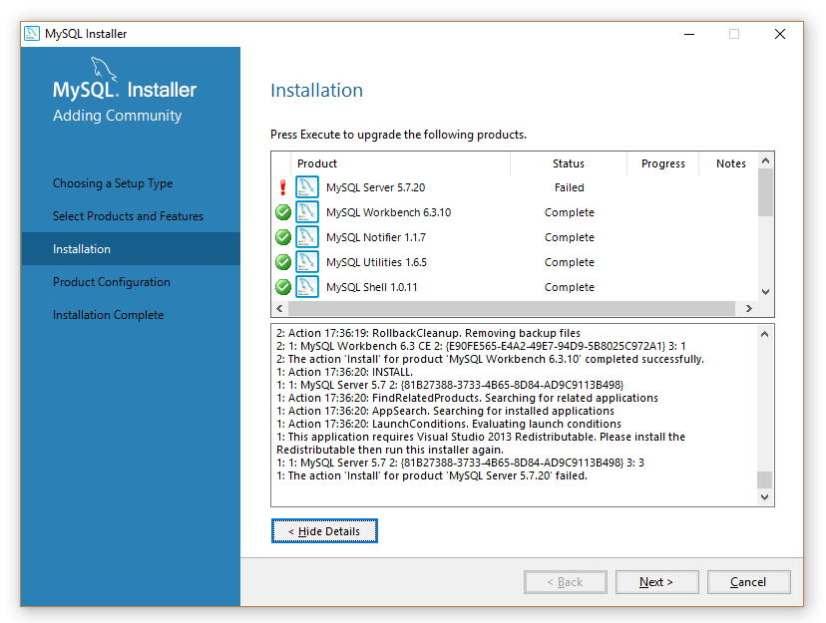
2.7.1. Failure
If you encounter 1: This application requires Visual Studio 2013 Redistributable. Please install the Redistributable then run this installer again.
then probably you did not install the right vcredist.

Slide 15
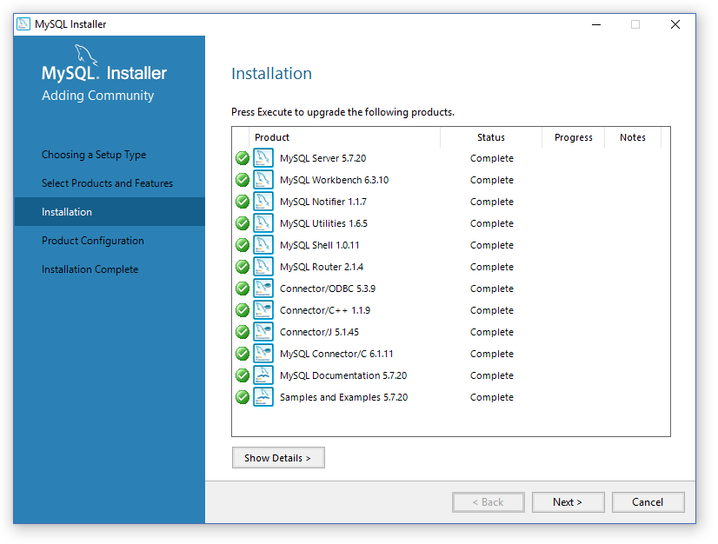
2.8. Wait
The packages need to be downloaded and installed.
When Status for all packages is Complete, click Next.

Slide 16
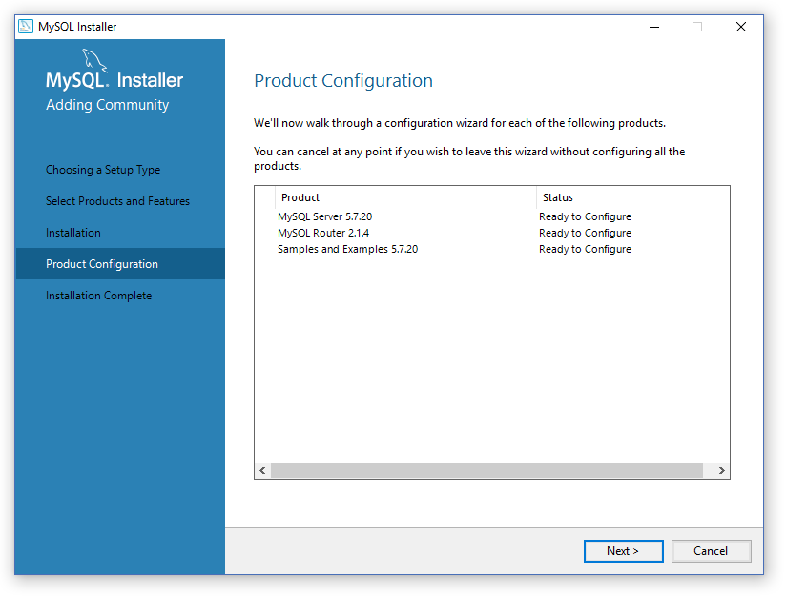
2.9. Product Configuration
From this point the configuration of components will be needed. Click Next to configure MySQL Server and MySQL Router.

Slide 17
3. MySQL Server configuration

Slide 18
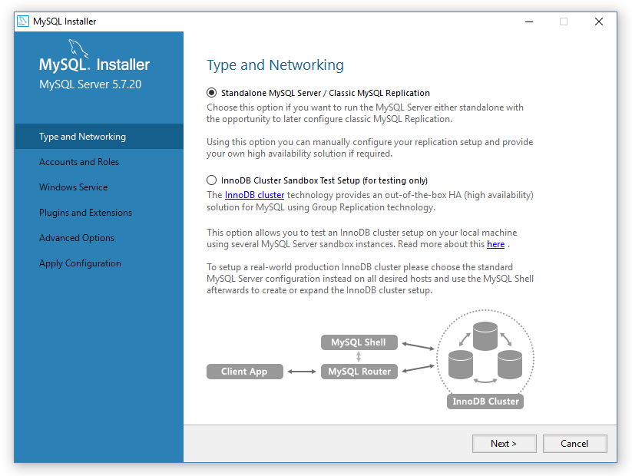
3.1. Type and Networking
Click Next.

Slide 19
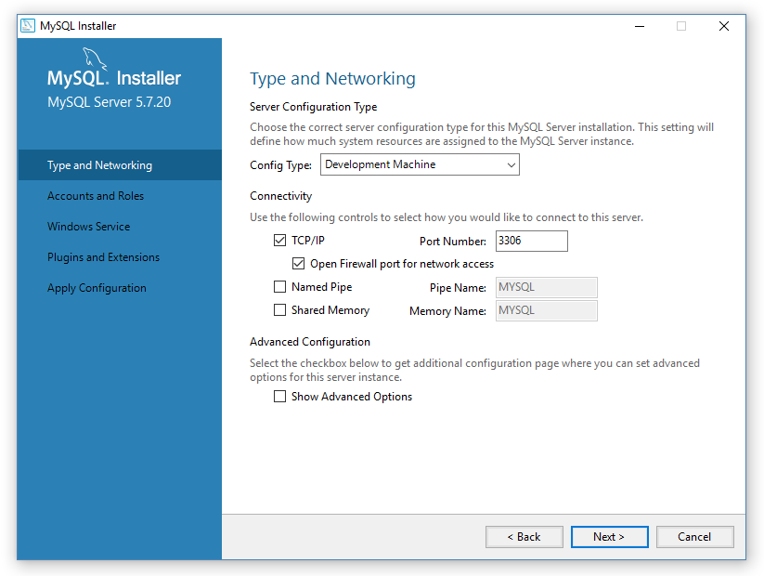
3.2. Type and Networking
Choose TCP/IP Port Number and click Next.

Slide 20
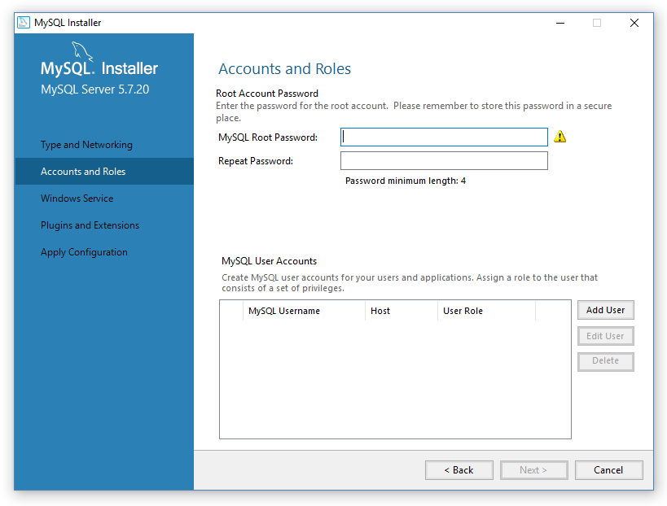
3.3. Accounts and Roles
Setup the MySQL Root Password and Add Users, then click Next.

Slide 21
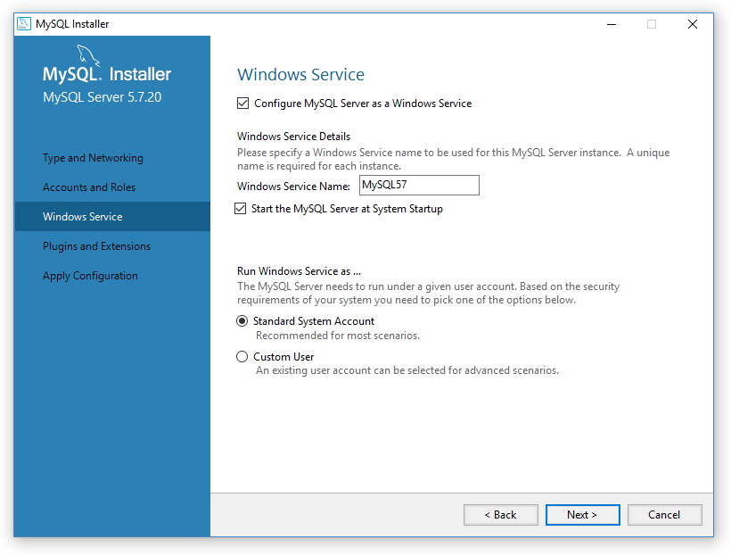
3.4. Windows Service
Configure MySQL Server.

Slide 22
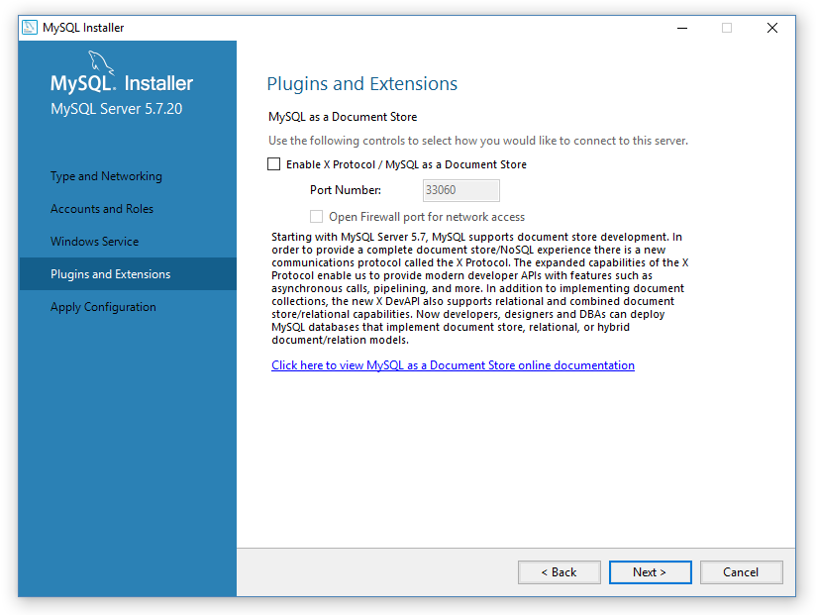
3.5. Plugins and Extensions
Click Next.

Slide 23
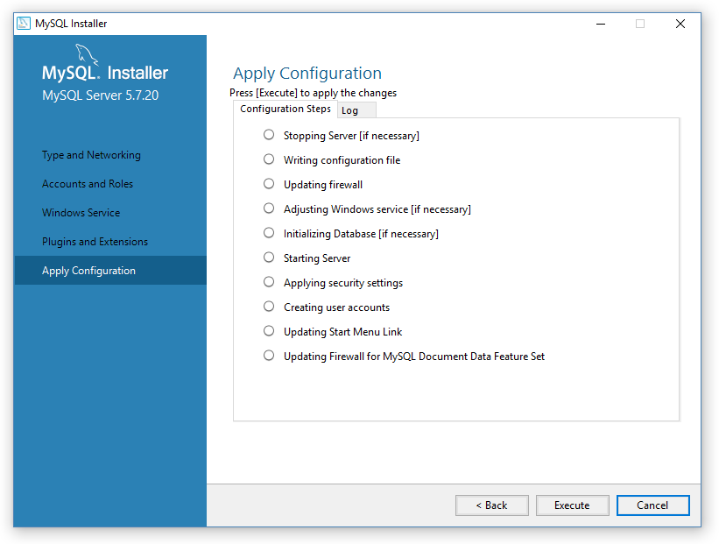
3.6. Apply Configuration
Click Execute to apply chosen MySQL Server configurations.

Slide 24
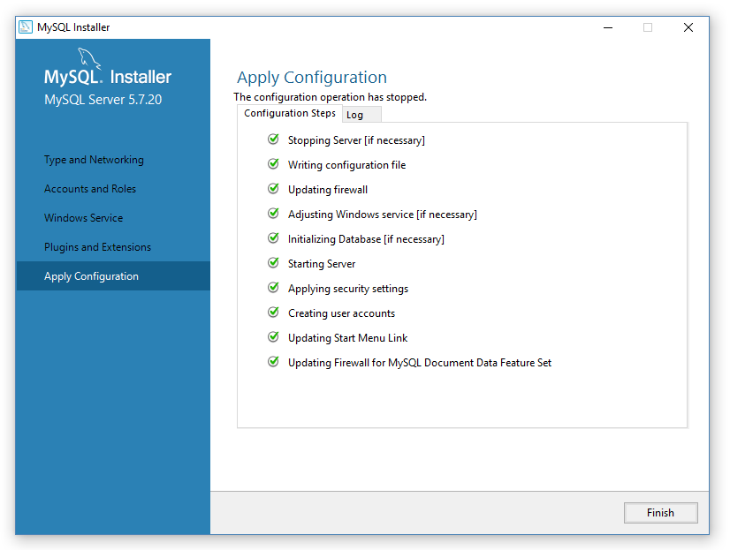
3.7. Finish MySQL Server configuration
Now you have successfully configured MySQL Server.
Click Finish.

Slide 25
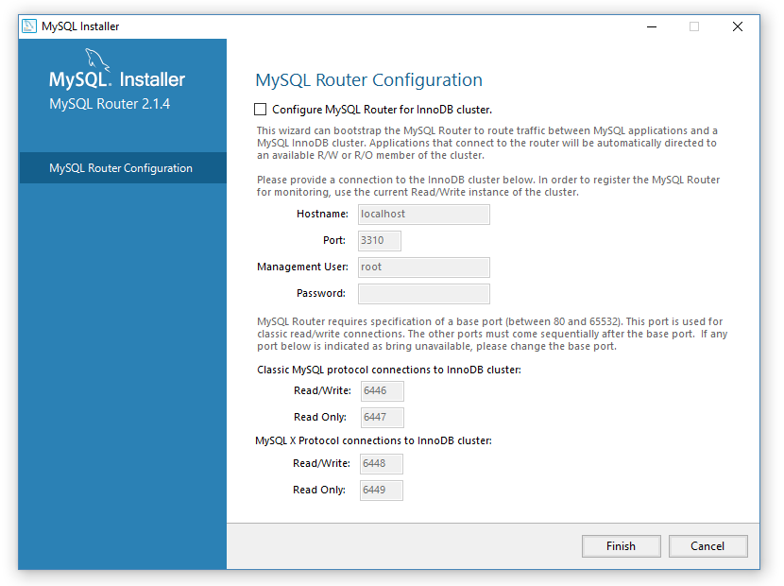
4. MySQL Router configuration
After configuring the MySQL Router, click Finish.

Slide 26
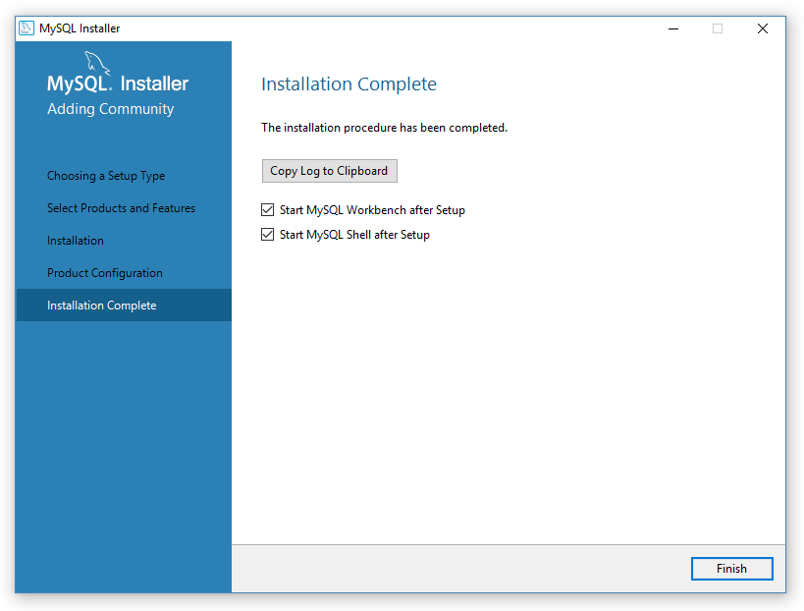
5. Installation complete!
Click Finish and proceed!

